Slide 1


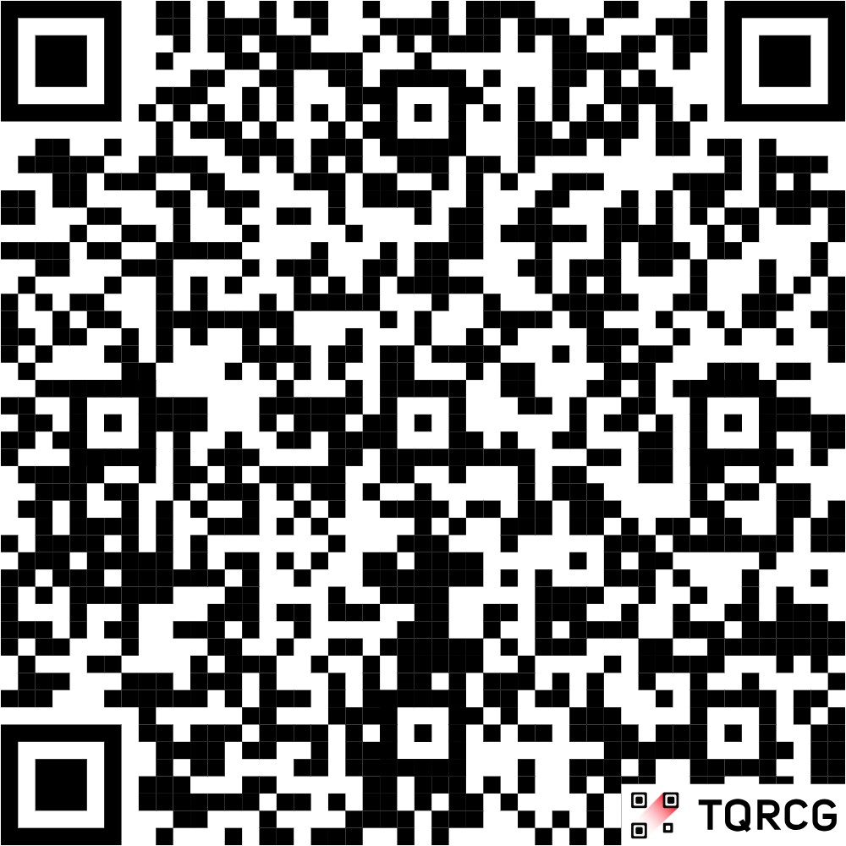
Does Your Child Have Myopia (Short-Sightedness)?
We are seeking your advice and feedback to help shape future myopia research
How Can You Help?
Details
We’re investigating the impacts of paediatric myopia. To help this, we want parents and their children to share their experiences with us so that we can cover what matters most to patients and families. We want to listen to you, as expert consultants, to get feedback on how we can improve our project.
Looking for parents, and their short-sighted child, to volunteer for a 2hr session
There will be opportunities to continue with future sessions if interested
All sessions will be held online in groups with other children and their parents
Children must be diagnosed with myopia and under-18
No previous research experience needed
What Do We Want to Know?
We want to know how myopia affects you and your family. Whether that’s through your finances, your emotions or your ability to do the things that you want to do.
We also want to know if you agree with our analyses and whether there’s anything that you think we ought to do differently!
Are You Interested?
Contact me:
talha.khan-israeel@postgrad.manchester.ac.uk
All sessions will be held online
Sessions will not be recorded
All information will remain confidential
Participants will receive compensation for their time
Scan QR for Email Address

